Slide 1
Machine Learning CS F464
Dr. Pranav M. Pawar

Slide 2
Contents
Unsupervised Learning
Clustering
K-means
Mixture of Gaussian and Expectation Maximization
Dimensionality reduction
PCA

Slide 3

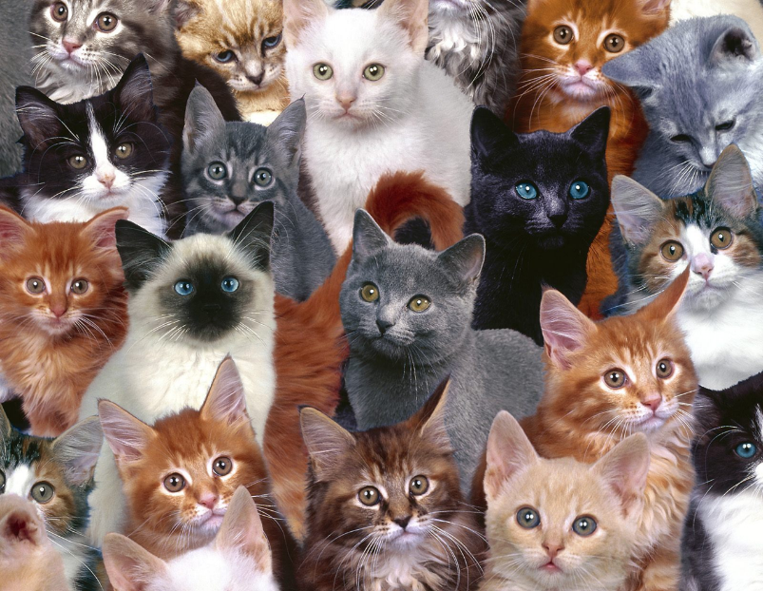
Clustering
Classification consists of assigning a class label to a set of unclassified cases.
Supervised Classification
The set of possible classes is known in advance.
Unsupervised Classification
Set of possible classes is not known. After classification we can try to assign a name to that class.
Unsupervised classification is called clustering.

Slide 4
K-means Clustering
K-Means clustering is an unsupervised iterative clustering technique.
It partitions the given data set into k predefined distinct clusters.
A cluster is defined as a collection of data points exhibiting certain similarities.
It partitions the data set such that-
Each data point belongs to a cluster with the nearest mean.
Data points belonging to one cluster have high degree of similarity.
Data points belonging to different clusters have high degree of dissimilarity.

Slide 5
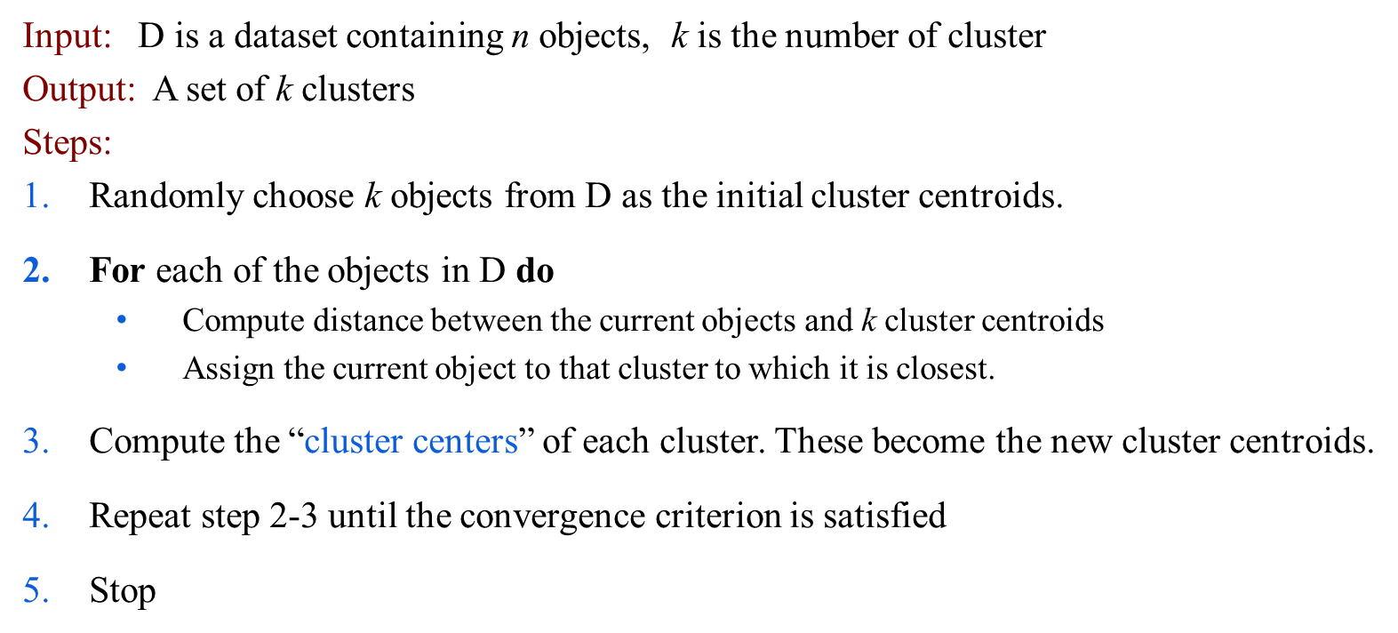
K-means Clustering Algorithm
Convergence criterion
Number of maximum iteration permissible, No change of centroid values in any cluster, Zero (or no significant) movement(s) of object from one cluster to another, Cluster quality reaches to a certain level of acceptance.

Slide 6
Example
Use k-means algorithm to create two clusters (k=2).

Slide 7
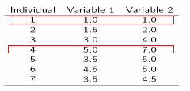
Example
Step1:
Initialization: Randomly we choose following two centroids (k=2) for two clusters. In this case the 2 centroid are: m1=(1.0,1.0) and m2=(5.0,7.0).

Slide 8



Step 2:
Thus, we obtain two clusters containing:
{1,2,3} and {4,5,6,7}.
Their new centroids are:

Slide 9
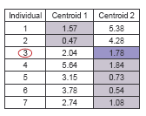
Step 3:
Now using these centroids we compute the Euclidean distance of each object, as shown in table.
Therefore, the new clusters are:
{1,2} and {3,4,5,6,7}
Next centroids are: m1=(1.25,1.5) and m2 = (3.9,5.1)

Slide 10
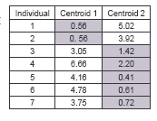
Step 4 :
The clusters obtained are:
{1,2} and {3,4,5,6,7}
Therefore, there is no change in the cluster.
Thus, the algorithm comes to a halt here and final result consist of 2 clusters {1,2} and {3,4,5,6,7}.

Slide 11
PLOT

Slide 12
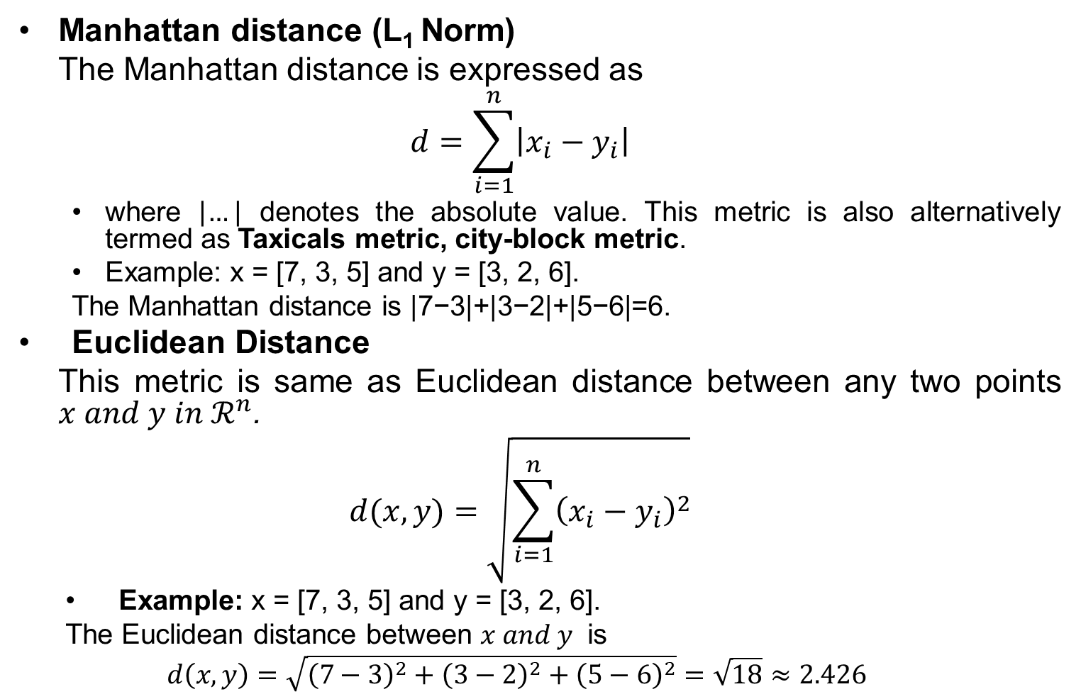
Distance Measures
Manhattan distance (L₁ Norm)
The Manhattan distance is expressed as
$$d=\sum_{i=1}^{n}{\left|x_{i}−y_{i}\right|}$$
where $\left|…\right|$ denotes the absolute value. This metric is also alternatively termed as Taxicals metric, city-block metric.
Example: x = [7, 3, 5] and y = [3, 2, 6].
The Manhattan distance is |7−3|+|3−2|+|5−6|=6.
Euclidean Distance
This metric is same as Euclidean distance between any two points $x and y in ℛ^{n}$.
$$d(x,y)=\sqrt{\sum_{i=1}^{n}{{\left(x_{i}−y_{i}\right)}^{2}}}$$
Example: x = [7, 3, 5] and y = [3, 2, 6].
The Euclidean distance between $x and y$ is
$$d\left(x,y\right)=\sqrt{{\left(7−3\right)}^{2}+{\left(3−2\right)}^{2}+{\left(5−6\right)}^{2}}=\sqrt{18}≈2.426$$

Slide 13
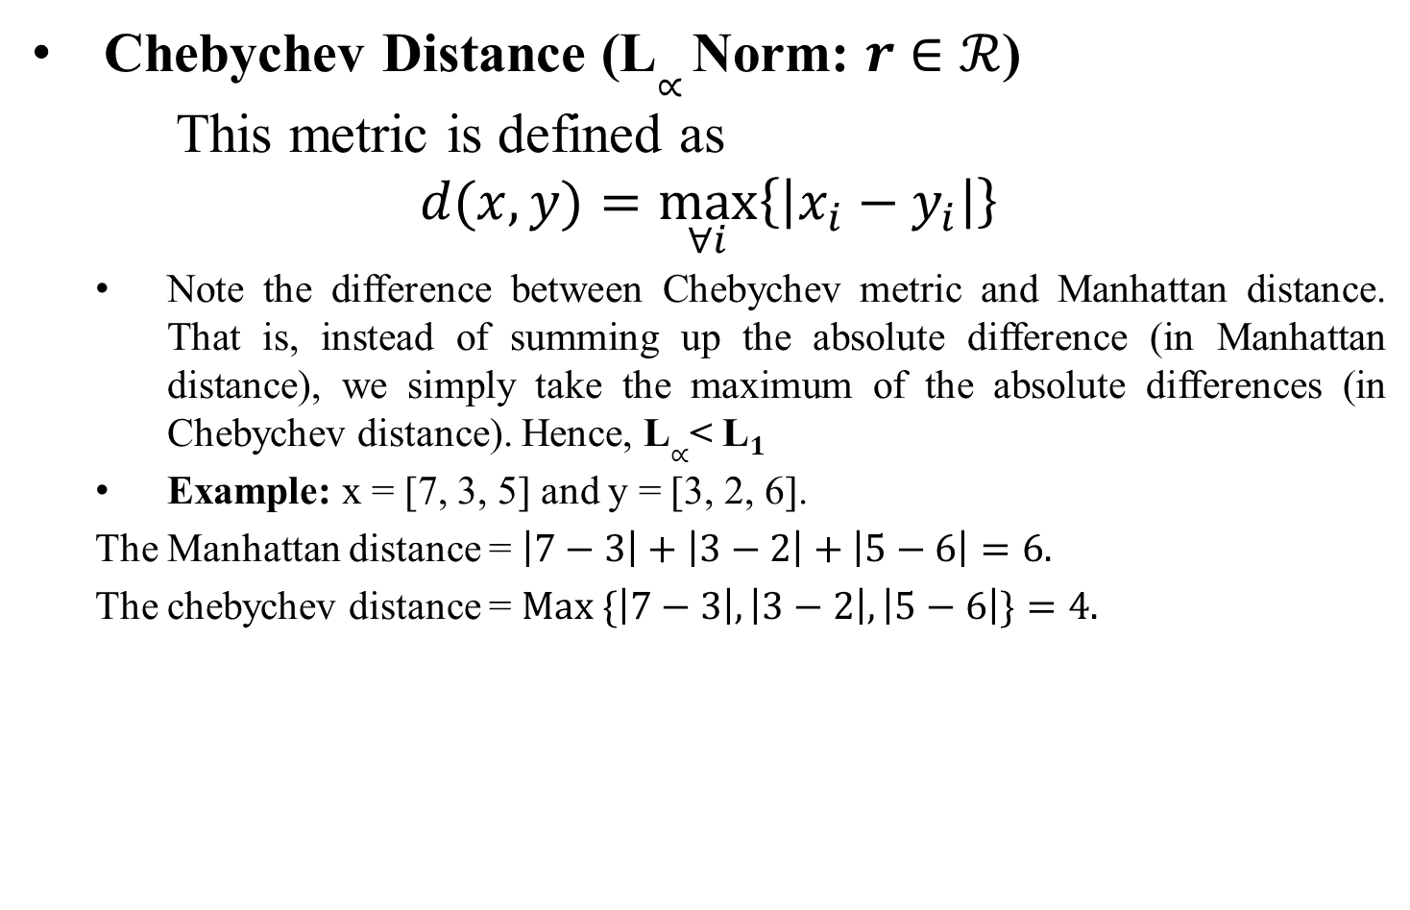
Distance Measures
Chebychev Distance (L$∝$ Norm: $r$ $∈ℛ$)
This metric is defined as
$$d(x,y)=\max_{∀i}\left\{\left|x_{i}−y_{i}\right|\right\}$$
Note the difference between Chebychev metric and Manhattan distance. That is, instead of summing up the absolute difference (in Manhattan distance), we simply take the maximum of the absolute differences (in Chebychev distance). Hence, L$∝$< L$1$
Example: x = [7, 3, 5] and y = [3, 2, 6].
The Manhattan distance = $\left|7−3\right|+\left|3−2\right|+\left|5−6\right|=6.$
The chebychev distance = $Max \{\left|7−3\right|,\left|3−2\right|,\left|5−6\right|\}=4.$

Slide 14
Advantages and Disadvantages
Advantages
It is relatively efficient and fast. It computes result at O(tkn), where n is number of objects or points, k is number of clusters and t is number of iterations.
Disadvantages
When the numbers of data are not so many, initial grouping will determine the cluster significantly.
The number of cluster, K, must be determined before hand. Its disadvantage is that it does not yield the same result with each run, since the resulting clusters depend on the initial random assignments.
We never know the real cluster, using the same data, because if it is inputted in a different order it may produce different cluster if the number of data is few.
It is sensitive to initial condition. Different initial condition may produce different result of cluster.
In K-means points can have only one class. What will if points lie in more than one group (common points)?

Slide 15
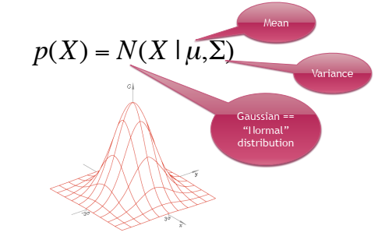
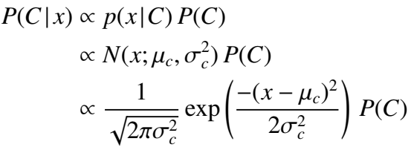
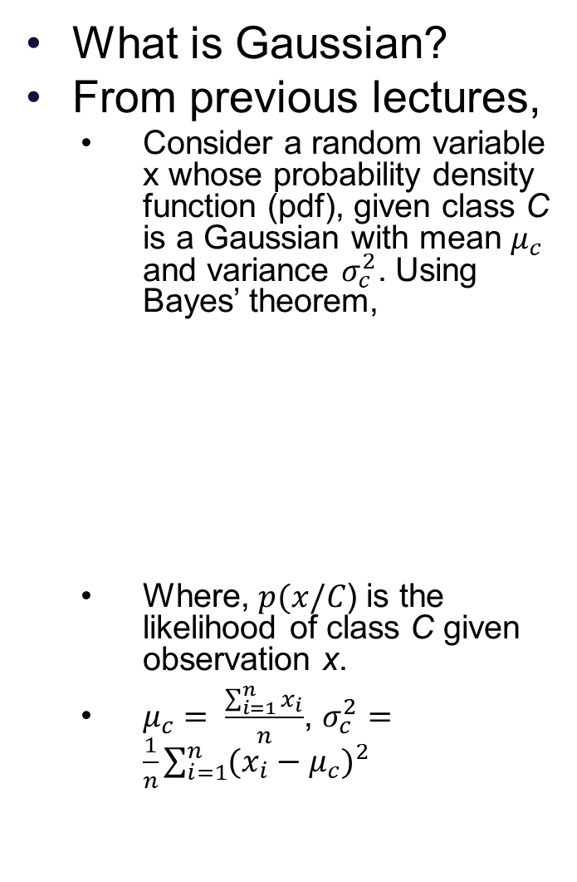
Mixture of Gaussian
What is Gaussian?
From previous lectures,
Consider a random variable x whose probability density function (pdf), given class C is a Gaussian with mean $μ_{c}$ and variance $σ_{c}^{2}$. Using Bayes’ theorem,
Where, $p(x/C$) is the likelihood of class C given observation x.
$μ_{c}= \frac{\sum_{i=1}^{n}{x_{i}}}{n}$, $σ_{c}^{2}=\frac{1}{n}\sum_{i=1}^{n}{{(x_{i}−μ_{c})}^{2}}$

Slide 16
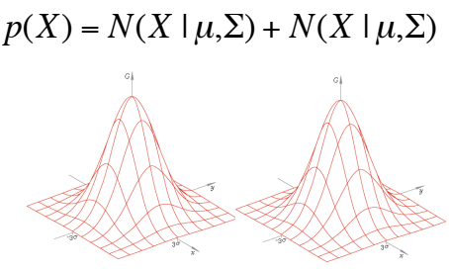
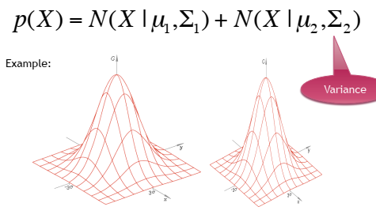
Gaussian Mixture
Gaussian Mixture with same variance
Gaussian Mixture with different variance

Slide 17
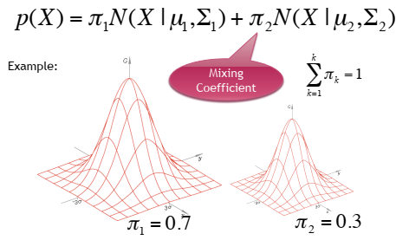
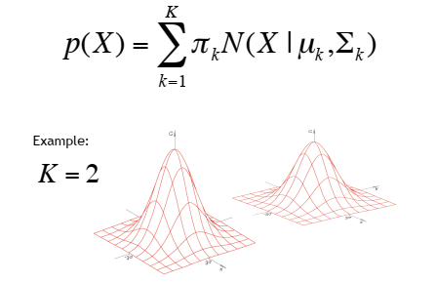
Gaussian Mixture
Gaussian Mixture with different variance and mixing coefficient
Definition of Gaussian Mixture

Slide 18
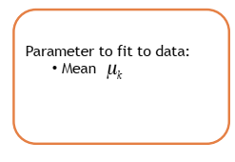
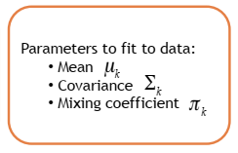
K-means → Gaussian Mixture
K-means is a classifier.
Hard-classifier (hard boundaries)
Mixture of Gaussian is a probability model.
We can use it as soft classifier.

Slide 19
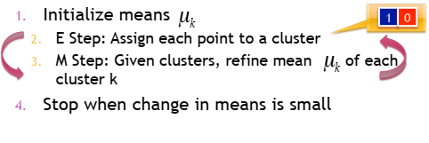
Expectation Maximization (EM) form of K-means

Slide 20
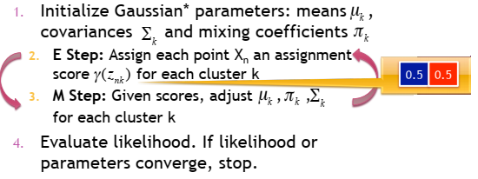
EM for Gaussian Mixture

Slide 21
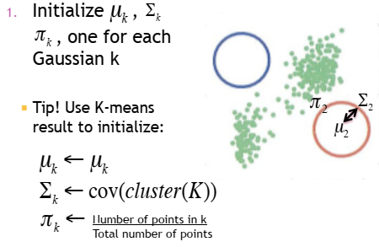
EM for Gaussian Mixture

Slide 22
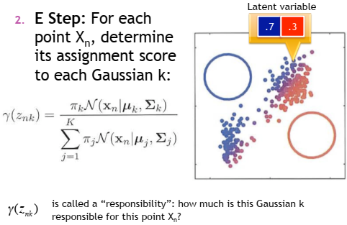
EM for Gaussian Mixture

Slide 23
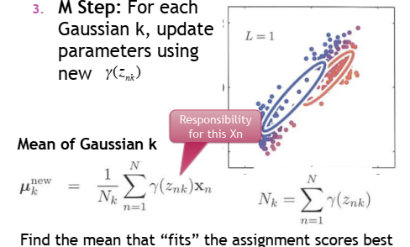
EM for Gaussian Mixture

Slide 24
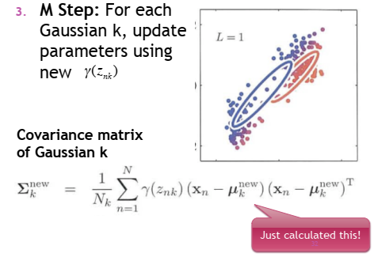
EM for Gaussian Mixture

Slide 25
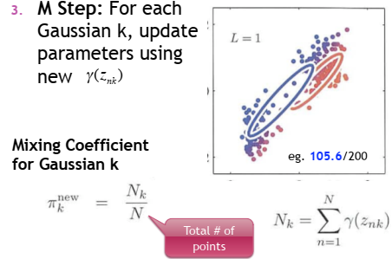
EM for Gaussian Mixture

Slide 26
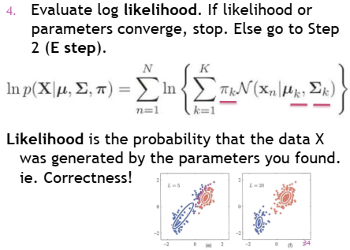
EM for Gaussian Mixture

Slide 27
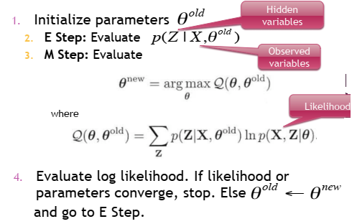
EM Algorithm : In General

Slide 28
Sources
Chapter 9, Christopher M. Bhisop, Pattern Recognition & Machine Learning, Springer, 2006.
Chapter 6 and 14, Marsland Stephen, Machine Learning – An Algorithmic Perspective, 2e, CRC Press,2015.
Chapter 6 and 7, Alpaydin Ethem. Introduction to Machine Learning, 3e, PHI, 2014.
http://www.facweb.iitkgp.ac.in/~sudeshna/courses/ml08
https://www.cse.unr.edu/~bebis/CS479/Lectures
https://cse.iitkgp.ac.in/~dsamanta/courses/da/resources
http://www.cvip.louisville.edu/wordpress/wp-content/uploads/2010/01/LDA-Tutorial-1.pdf

Slide 29
Thank You!

